Slide 1
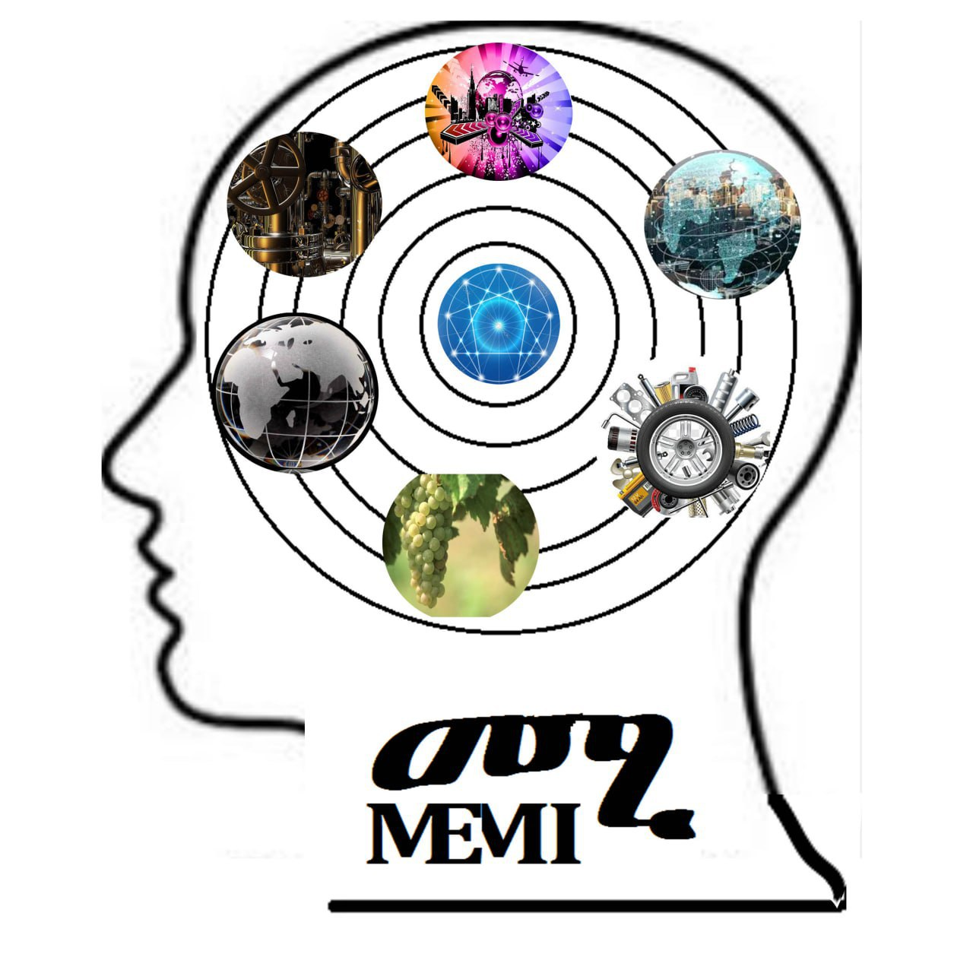

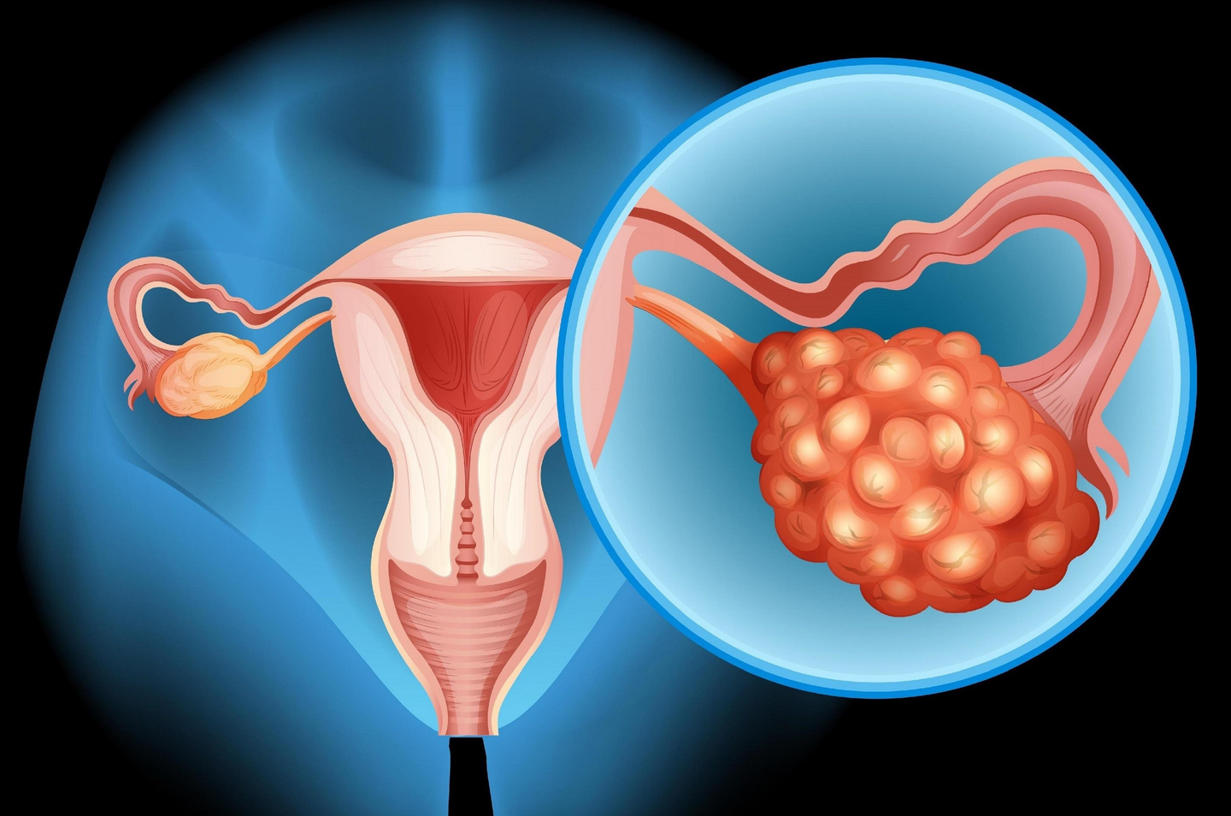
MMOTU: INTELLIGENT OVARIAN TUMOR DIAGNOSIS
Dual-Stage Deep Learning for Automated Segmentation and Classification
Betelhem Getachew Kebede
December,2025

Slide 2
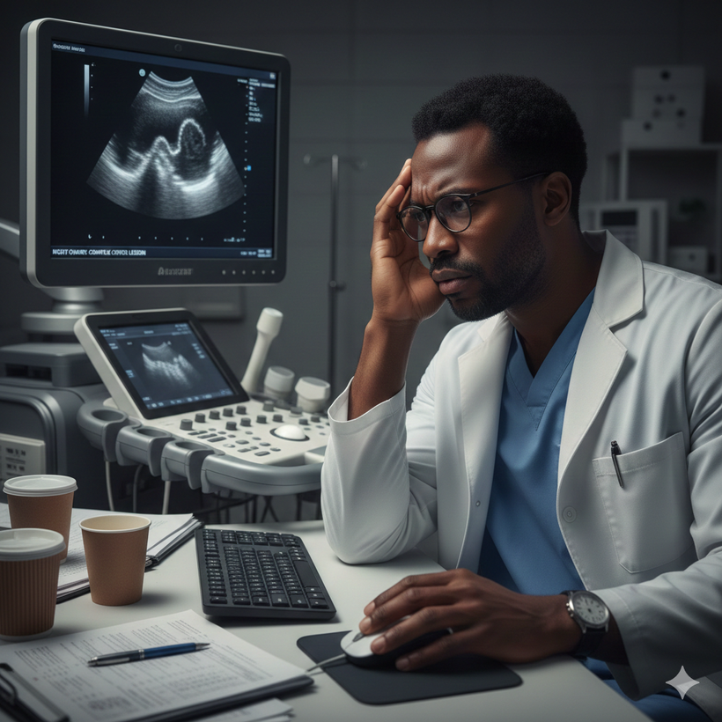
Problem Statement
Accurate ovarian tumor diagnosis from ultrasound images is difficult due to unclear tumor boundaries, visual similarity across tumor types, and reliance on expert interpretation, necessitating an automated AI system for reliable tumor segmentation and classification.

Slide 3

Clinical Motivation
•Ovarian cancer is a leading cause of gynecologic cancer mortality.
•Ultrasound interpretation is operator-dependent and error-prone.
•AI can provide consistent, rapid, and objective diagnostic support.

Slide 4
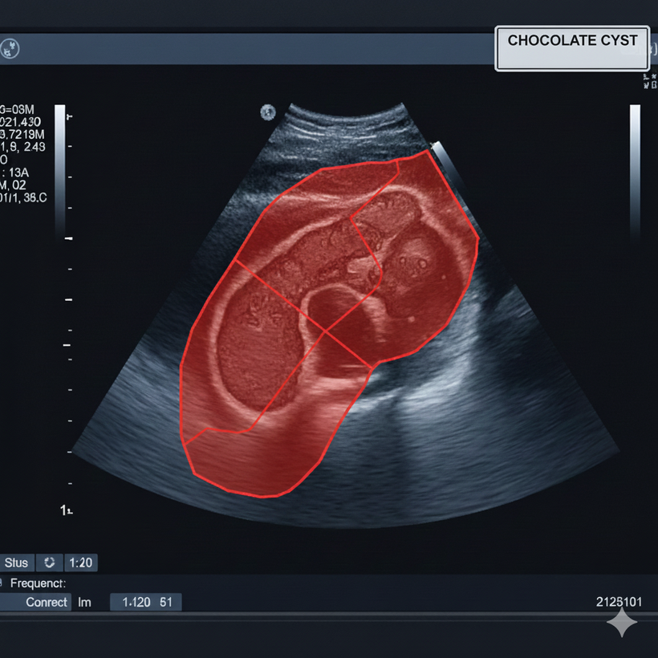
Objectives
  Automatically segment ovarian tumors from ultrasound images
  Classify tumors into 8 clinically relevant categories
  Build an integrated, interpretable diagnostic pipeline

Slide 5
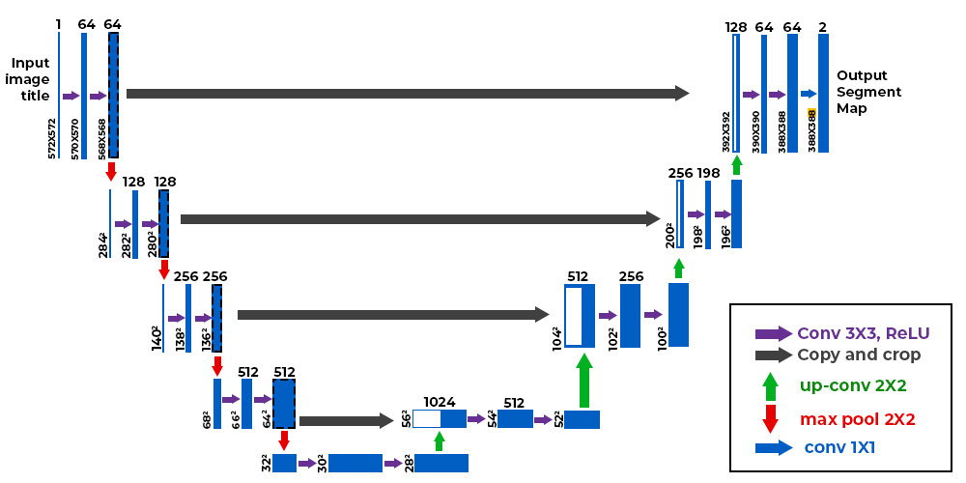
Methodology: Tumor Segmentation
  Architecture: U-Net with ResNet34 encoder.
  Objective: Pixel-level tumor boundary detection.
  Loss Function: Hybrid Binary Cross-Entropy + Dice Loss.
  Training: 50 epochs with ImageNet pre-training.

Slide 6
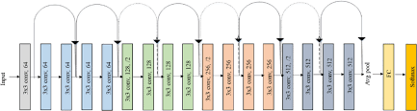
Methodology: Tumor Classification
  Architecture: ResNet18 CNN.
  Input: Segmented tumor region (ROI).
  Output: 8-class ovarian tumor classification.
  Decision: Softmax probability-based prediction.

Slide 7
Model Performance Results
  Segmentation: Dice Score = 84.85%, Mean IoU = 76.68%.
  Classification: Best Validation Accuracy = 71.86%.
  Pixel Accuracy: 97.04%.
  Early stopping applied for generalization control.

Slide 8
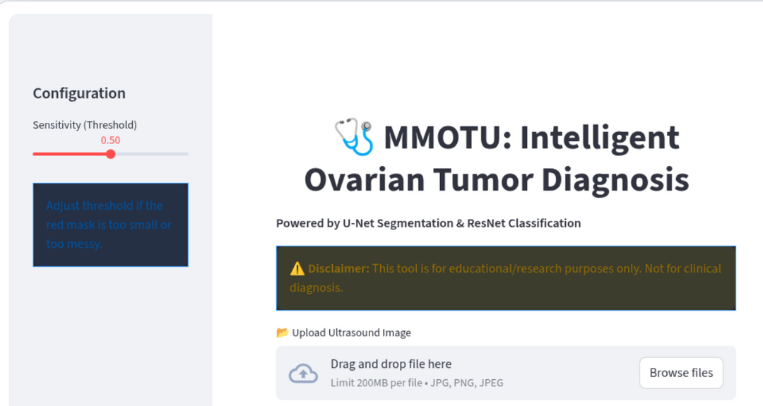
System Deployment
  Implemented using Streamlit for real-time inference.
  User uploads ultrasound image.
  Automated segmentation, classification, and reporting.

Slide 9
Automated Medical Reporting
  Instant PDF report generation.
  Includes diagnosis, confidence scores, and timestamps.
  Supports clinician notes and interpretation.
  Designed for clinical usability.

Slide 10
Conclusion and Future Work
  Successfully developed an end-to-end AI diagnostic pipeline.
  Demonstrated strong segmentation and classification performance.
  Future work includes attention mechanisms and 3D ultrasound data.

Slide 11
THANK YOU
TRY THE DEMO: INTELLIGENT OVARIAN TUMOR DIAGNOSIS

